Slide 1
Europass - VocBench in practice
30 March 2022

Slide 2
Background: Europass

Slide 3
Europass: Overview
Digital Credentials
Encompasses technical specifications to implement the framework. It comprises of core building blocks to help operationalise the framework: e-IDAS, Standards, Services and Software
Information provision
Interoperability mechanism
Provide information or links to available information on skills and qualifications that help users to better manager their lifelong career
Enables the exchange of information on skills and qualifications amongst different actors
e-Portfolio
Support individuals to document and describe their skills, qualifications and experience and to manage their career from a lifelong learning perspective

Slide 4
Europass: Data Modelling
Data models covering^{[1]}:
Based on existing standards, such as:
HR Open^{[2]} | W3C Verifiable Credentials^{[3]} | ELMO/EMREX Standard^{[4]} | DCMI Metadata Terms^{[5]}
Curriculum
Vitae
Courses
(Qualifications and
Learning Opportunities)
Learning
Credentials
[1] https://europa.eu/europass/en/interoperability-europass
[2] https://www.hropenstandards.org/
[3] https://www.w3.org/TR/vc-data-model/
[4] https://github.com/emrex-eu [5] https://www.dublincore.org/specifications/dublin-core/dcmi-terms/

Slide 5
Europass: Modelling structure
01 European Information Model
Definitions and Standards in EQF Recommendation, Diploma Supplement, Europass Recommendation, etc. supplemented by glossaries for additional terms
02 European Learning Model
01
A Linked Open Data publication of concepts to be used in educational and employment use cases throughout Europe
03 Application Profiles
02
Specific sets of rules for publishing learning opportunities, qualifications, accreditations and credentials in Europass
03
04 Extensions
National, Regional or Sectoral extensions of the data model & application profiles to deal with specific use cases
04

Slide 6
VocBench Use-case: Management of controlled vocabularies

Slide 7
Introduction
Same as the data models the Europass controlled vocabularies aim to be interoperable
The controlled vocabularies are published for alignment among:
- Individual services of Europass: to align the used reference among them
- End-users: describe their experiences, personal information or skills
- Stakeholders: gain a common understanding across used languages

Slide 8
Type of controlled vocabularies
In-house vocabularies, developed and managed by Europass
Vocabularies originating elsewhere but managed by Europass
EC Managed vocabularies, authored and managed by the EC
Third-party managed vocabularies, authored and/or managed by third parties

Slide 9
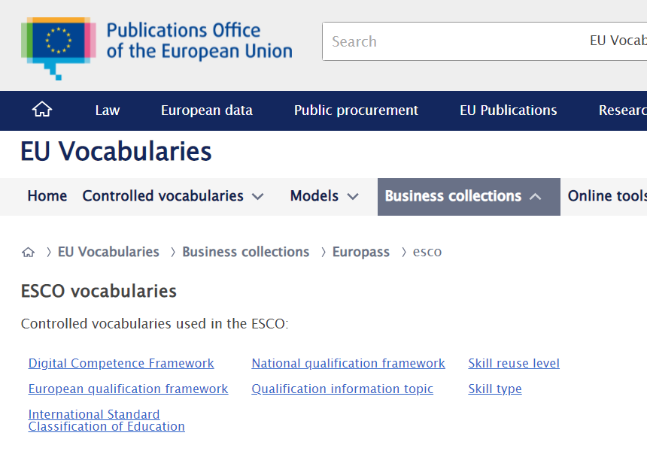
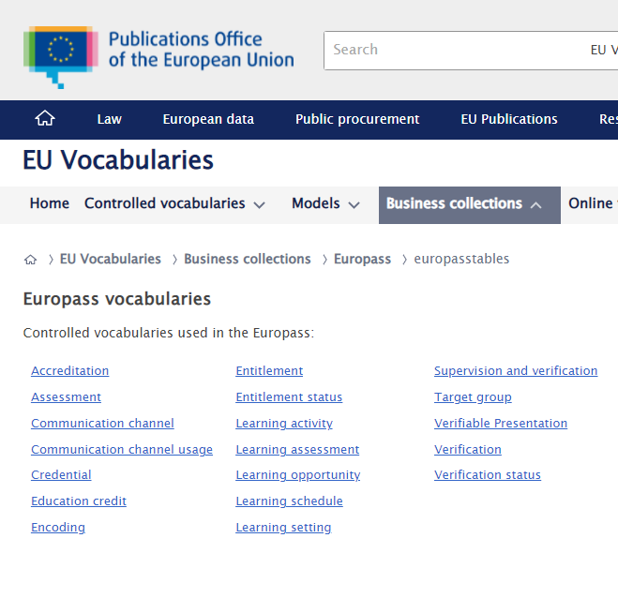
Role of VocBench
All Europass-managed vocabularies are created and maintained using VocBench
The results are published under Europass (and ESCO) Business Collections^{[6] [7]}
The maintenance is consisting of manual interventions and bulk imports of data (e.g., for translations of the data)
[6] https://op.europa.eu/en/web/eu-vocabularies/europasstables
[7] https://op.europa.eu/en/web/eu-vocabularies/esco

Slide 10
VocBench Use-case: Benefits

Slide 11
VocBench Use-case: Benefits
VocBench service meet the needs for management of Europass vocabularies:
- Editing environment with manual and import editing
- Automated validation and publication of the results
The service offers both:
- Standardisation of the produced information: fixed namespace for Business collections and LOD practices
- Flexible workflow: allowing the creation of new lists within the collection as needed, as well as editing existing ones

Slide 12
VocBench Use-case: Benefits
EU Vocabularies and Cellar furthermore offer a strong publication pipeline of Europass vocabularies:
- Dereferenceability of URIs
- SPARQL endpoint of the publication
- Clear source of truth of the data for different services within the Europass
- Versioning of the controlled vocabularies

Slide 13
Thank you

