Slide 1
Cellar: APIs and SPARQL training The Common Data Repository of the Publications Office
Publications Office of the EU
Directorate A: Data, Information and Knowledge Management Services
Unit A3: Digital Solutions and Process Efficiency
Section A3.001: Development of and Support for Dissemination Systems
2025
Notes:
Speaker: Emmanuelle

Slide 2
Agenda of the training
Part 1: Summary of important concepts
Part 2: Identify the correct interface to query Cellar
Part 3: Accessing content using REST API
Part 4: Retrieving feeds/notifications about ingestion from REST API
Part 5: Accessing metadata using REST API
Part 6: Accessing metadata using SPARQL
Part 7: SPARQL Mapper
Part 8: Questions and answers

Slide 3
Who are the trainers?
Emmanuelle Gaillard, A3.001, IT Officer emmanuelle.gaillard@publications.europa.eu
Marko Vujasinovic, A3.005, Consultant marko.vujasinovic@ext.publications.europa.eu
Abdelfettah Feliachi, A3.005, Consultant abdelfettah.feliachi@ext.publications.europa.eu
Xavier Chapelant, A2.004, Consultant
xavier.chapelant@ext.publications.europa.eu

Slide 4
Part 1
Summary of important concepts
Notes:
Speaker: Abdel

Slide 5
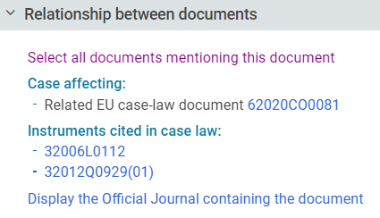
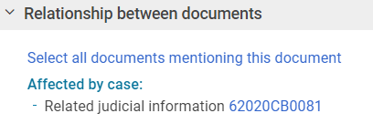
Our data are linked by default
Part 3: Data

Slide 6
Data layers in Cellar
Part 3: Data
Structure and Formats
Semantics
METADATA: Structured data about the digital content
DATA: Digital Content
(documents in specific file formats and EU languages)
COMMON VOCABULARY
AUTHORITY TABLES
THESAURI
Data Definition Layer
Data Layer
Knowledge
Graph
Knowledge Base
Notes:
Say that Data + Data Definition Layers are in fact the Cellar Knowledge Graph.

Slide 7
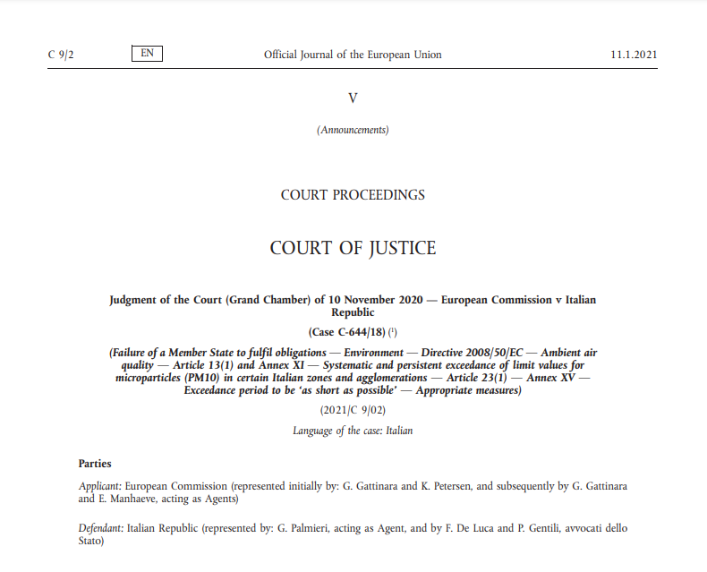
WEMI
CDM defines subtypes of Work, including General Publication, Official Journal, Special edition of General Publication, Legal Resource, Consolidated act, Preparatory act, etc.
Part 3: Data
Expression
Manifestation
Item
Work
Official
Journal
(JOC 2021 009)
ENG
pdf
ALL 23/24 LVs
fmx4
xhtml
FRA
digital item (physical file)
High-level concept, an intellectual or artistic creation, for example a specific Official Journal
expression_
belongs_to_work
Language level; linguistic version of the work
manifestation_
manifests_expression
Format level; a format of specific linguistic version of the work
item_
belongs_to_
manifestation
Physical/digital file level – file itself
Notes:
CDM based on FRBR (Functional Requirements for Bibliographic Record) to present a publication at different levels of abstraction: Work, Expression, Manifestation, and Item (WEMI)
WEMI hierarchy in cellar
Work: high-level abstract -- The representation of a specific OJ
Expression: language level – The representation of the French version of the specific OJ
Manifestation: format level – The representation of the pdf format of the French version of the specific OJ
Item: physical/electronic file level – The file itself

Slide 8
Metadata are represented as triples
Part 3: Data
A triple = subject – property – object
This 3 part structure is named triple and are grouped in RDF format
The french pdf of the OJ 123
has_type
« pdf »
The OJ 123
cites
the OJ 456

Slide 9
Knowledge graph
Part 3: Data
Guaranteed at the Semantic store level
Possibility to store and retrieve RDF data based on various ontologies
eProcurement ontology, Whoiswho data, Master data.
Our Knowledge Graph (=triple store): Virtuoso
Triples are way to model metadata.
Triples from RDF are stored in Virtuoso.
Users can query Virtuoso using a query language, SPARQL.
Inferred metadata is NOT stored in Virtuoso
Digital content is NOT stored in Virtuoso
SPARQL Endpoint
Virtuoso

Slide 10
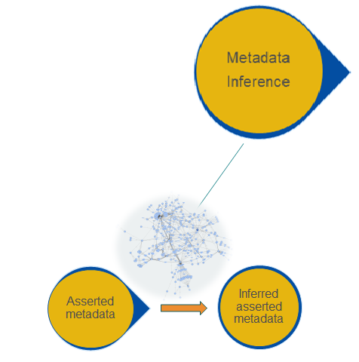
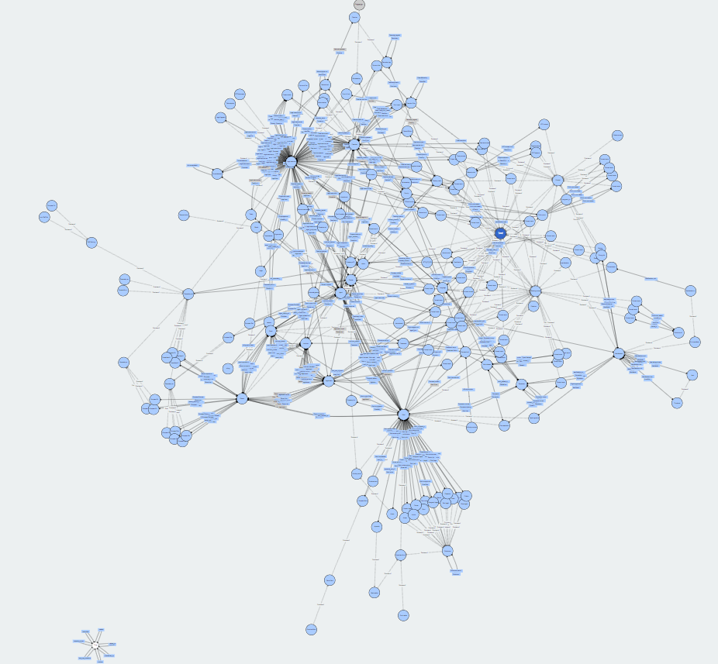
Inference
Part 2: Architecture
Inferred metadata is stored in Cellar
(Deductive) Inference is the process of deriving new knowledge from existing (asserted) knowledge based on a logical reasoning.
Ontologies formalize the logic to provide a frame for inference.
Knowledge inference is another way to do AI.
cites
Inverse of
cited by
cites
Doc1
cites
Doc2
Doc1
Doc2
cited by

Slide 11
Cellar’s resource identifiers (URI)
Part 4: Practical session
Resources in Cellar are identified by their unique identifiers which take the form of Web URIs.
For example:
http://publications.europa.eu/resource/cellar/c686c133-cb43-11ec-b6f4-01aa75ed71a1 | Work
http://publications.europa.eu/resource/cellar/c686c133-cb43-11ec-b6f4-01aa75ed71a1.0006 http://publications.europa.eu/resource/cellar/c686c133-cb43-11ec-b6f4-01aa75ed71a1.0013 | Expression
http://publications.europa.eu/resource/cellar/c686c133-cb43-11ec-b6f4-01aa75ed71a1.0013.01 | Manifestation
http://publications.europa.eu/resource/cellar/c686c133-cb43-11ec-b6f4-01aa75ed71a1.0006.01/DOC_1 | Item
http://publications.europa.eu/resource/authority/country/BEL | Concept
http://publications.europa.eu/resource/directory/person/EURCOU_IND-CONSIL.BELFED.01 | Person
Notes:
{work-id} is a valid Universally Unique Identifier (UUID)
{expr-id} is a 4-chars numeric value
{man-id} is a 2-chars numeric value
{cs-id} is an alphanumeric value with following pattern: DOC_x, where x is an incremental numeric value that identifies the content stream

Slide 12
Cellar’s resource identifiers (URI)
Part 4: Practical session
From the business reason, a resource can have multiple identifiers (Cellar identifier and business identifiers)
http://publications.europa.eu/resource/cellar/c686c133-cb43-11ec-b6f4-01aa75ed71a1
http://publications.europa.eu/resource/oj/JOC_2022_182_R_0001
http://publications.europa.eu/resource/celex/52022XC0504%2801%29
Work | http://publications.europa.eu/resource/oj/JOC_2022_182_R_0001
Expression | http://publications.europa.eu/resource/oj/JOC_2022_182_R_0001.ENG
Manifestation | http://publications.europa.eu/resource/oj/JOC_2022_182_R_0001.ENG.xhtml
Item | http://publications.europa.eu/resource/oj/JOC_2022_182_R_0001.ENG.xhtml.C_2022182EN.01000101.doc.html
Notes:
cellar, celex, oj, com, genpub, ep, jurisprudence, dd, mtf, consolidation, eurostat, eesc, cor, nim, pegase, transjai, agent, uriserv, join, swd, comnat,mdr, legissum, ecli, procedure, procedure-event, eli, immc and planjo.
https://forms.office.com/e/jaz1v3GqzV

Slide 13
Let’s see how to access Cellar data
Part 4: Practical session
REST API
metadata, content streams,
concepts def.
RSS
notification of ingestion
VIRTUOSO
metadata, who-is-who data,
authority lists, etc.

Slide 14
Part 2
Identify the correct interface to query Cellar: user stories
Notes:
Speaker: Marko

Slide 15
User story: As a developper, I want to train my model
I need to harvest data:
Legal domain + multi-domain
Multilingual
Why not using Cellar?
I will ask in Virtuoso to extract URLs of 100 000 pdf x each language
Then, from each URL, I will download the pdf file

Slide 16
User story: As a lawyer, I need info about a case-law
I know the specific URL of a case-law
I need information about this case-law like:
Which resource legal the case-law interpretes ?
By which judge the case law is delivered ?
…
I will download the rdf notice of this case-law.

Slide 17
Should have to use API or VIRTUOSO to retrieve metadata?
API
VIRTUOSO
I want to extract the full direct metadata of a publication (I can also focus on a language or format)
I want to extract the full inferred metadata of a publication
I need to know the URL (cellar id or psi id) of the publication
I want to list publications according to some criterias (collection, topic, format, etc.)
I want to browse relations between publications
I want to extract direct metadata of a publication

Slide 18
Part 3: Accessing content using REST API

Slide 19
How to retrieve content streams (digital files), for example a publication in PDF ?
Cellar’s REST API

Slide 20
REST API
HTTPS operations to retrieve digital content
Retrieve digital content from its cellar id
Retrieve digital content from its production id
Retrieve digital content from the cellar id/production id, a language and a format

Slide 21
How to retrieve content streams (digital files), for example a publication in PDF from the REST API?
Cellar REST API
Using Web browsers, only if you know an ID of XHTML Manifestation or if you know a file id
Using REST API clients such as cURL or Postman

Slide 22
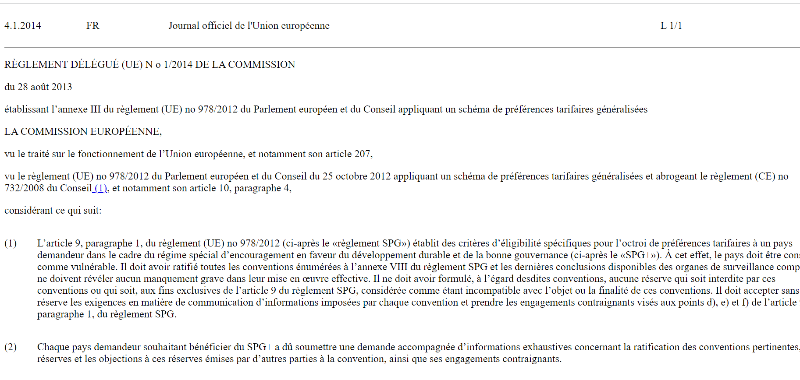
Retrieve content stream: using Web browser
Cellar REST API
if user « knows » identifier of XHTML manifestation, either Cellar or production system one (oj, celex, etc)
https://publications.europa.eu/resource/oj/JOL_2014_001_R_0001_01.FRA.xhtml
http://publications.europa.eu/resource/cellar/b84f49cd-750f-11e3-8e20-01aa75ed71a1.0010.03
Notes:
https://publications.europa.eu/resource/cellar/1da26cfe-475c-11ec-91ac-01aa75ed71a1.0001.01/DOC_1
pdfa1a

Slide 23
Retrieve content stream: using Web browser
Cellar REST API
If user « knows » identifier of a file
http://publications.europa.eu/resource/cellar/b84f49cd-750f-11e3-8e20-01aa75ed71a1.0010.03/DOC_1
http://publications.europa.eu/resource/cellar/b84f49cd-750f-11e3-8e20-01aa75ed71a1.0010.01/DOC_1
Notes:
https://publications.europa.eu/resource/cellar/1da26cfe-475c-11ec-91ac-01aa75ed71a1.0001.01/DOC_1
pdfa1a

Slide 24
Retrieve content streams: using REST API Client (Postman)
Cellar REST API
A content stream (file) can be retrieved given the manifestation type (e.g., XHTML or PDF), the work identifier (e.g., identifier of OJ) and the expression (e.g., French, English, Italian, etc)
GET http://publications.europa.eu/resource/{ps-name}/{psid}
HTTP headers must be set on the request:
Accept:{mime-type}, where {mime-type} is a valid (or a comma-separated list of) mime type that identify the format of the content stream to return e.g. Accept: application/pdf
Accept-Language:{acc-lang}, where {acc-lang} is a 3-chars ISO_639-3 language code identifying the accept language to use: this will be used for retrieving the correct expression. For example, Accept-Language: fra, eng
Allowed mime-types and languages are listed on https://op.europa.eu/en/web/cellar/cellar-data/publications

Slide 25
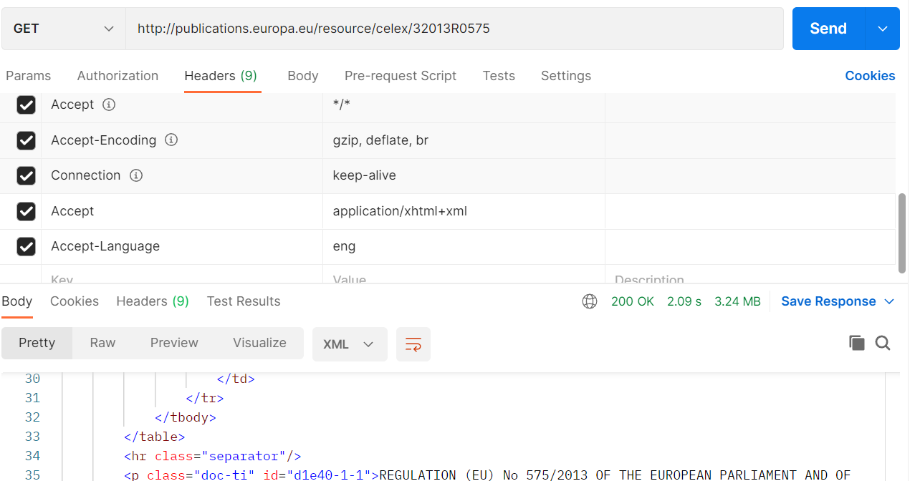
Retrieve content stream: using REST API
Cellar’s REST API
curl "http://publications.europa.eu/resource/celex/32013R0575" -H 'Accept: application/xhtml+xml' -H 'Accept-Language:eng'
Postman:

Slide 26
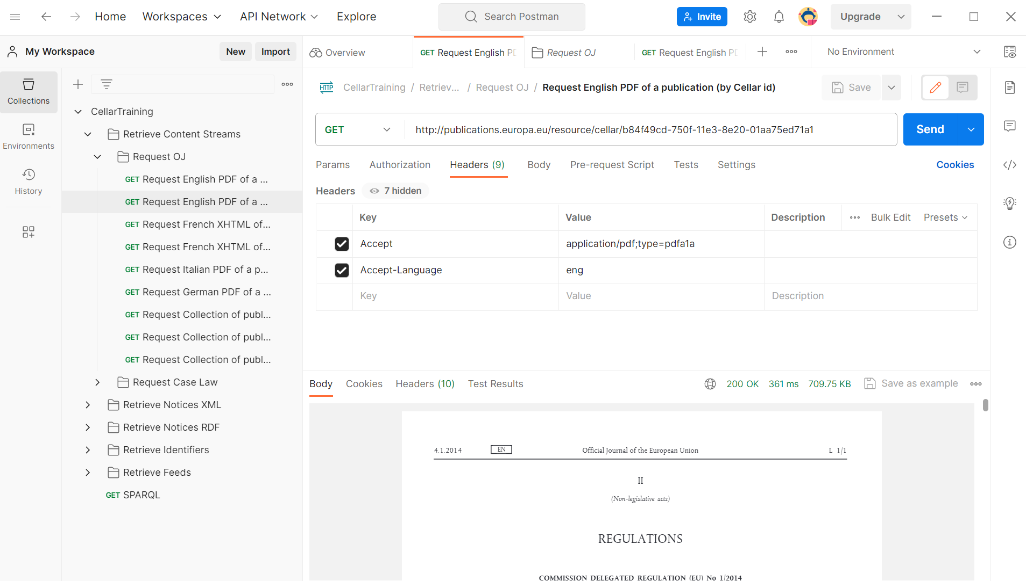
Let’s try out some requests from Postman!
Cellar’s REST API: Retrieve content
Notes:
For example, lets find publication which title starts with “'Commission Delegated Regulation (EU) No 1/2014 of 28 August 2013 establishing Annex III to Regulation (EU) No 978/2012”…
prefix cdm: <http://publications.europa.eu/ontology/cdm#>
select ?work ?exp where {
?exp cdm:expression_belongs_to_work ?work.
?exp cdm:expression_title ?title .
?exp cdm:expression_uses_language <http://publications.europa.eu/resource/authority/language/ENG> .
filter (strstarts(?title, 'Commission Delegated Regulation (EU) No 1/2014 of 28 August 2013 establishing Annex III to Regulation (EU) No 978/2012')) .
}

Slide 27
Part 4: Retrieving feeds/notifications about ingestion from REST API

Slide 28
Notifications: RSS and Atom feeds
Notification service provides information about the ingesting of documents, the loading of NALs and the loading of ontologies in the form of an RSS or Atom feed.
By accessing these feeds, it is possible to get a complete history of the performed actions.

Slide 29
RSS FEED
HTTPS operations to be notified about creation/update of objects
Retrieve last updated objects
Retrieve last created objects
Retrieve last update of vocabulary

Slide 30
Ingestion feed
Notifications (Feeds)
http://publications.europa.eu/webapi/notification/ingestion?{parameters}
Provides an overview of all ingestion actions, filtered by the given parameters.
− startDate: Defines the date (inclusive) since which the ingestion notifications shall be retrieved.
- endDate: Defines the date (inclusive) until which the ingestion notifications shall be retrieved
− type: A string value, either CREATE, UPDATE or DELETE. It defines the type of ingestion to be retrieved
− wemiClasses: A comma-separated list of WEMI classes: work, expression, manifestation, item, dossier, event or agent
− page: The number of the page on the feed to display. This parameter may be used to page large results.
Notes:
Dataformats:
Its format must match one of the following:
• yyyy-MM-dd (2013-12-02)
• yyyy-MM-dd'T'HH:mm:ss (2013-12-02T09:24:22)
• yyyy-MM-dd'T'HH:mm:ssZZ (2013-12-02T09:24:22-01:00)
• yyyy-MM-dd'T'HH:mm:ss.SSSZZ (2013-12-02T09:24:22.123-01:00).

Slide 31
NAL and ontology feed
Notifications (Feeds)
http://publications.europa.eu/webapi/notification/nal?{parameters}
http://publications.europa.eu/webapi/notification/ontology?{parameters}
Params:
− startDate: Defines the date (inclusive) since which the notifications shall be retrieved.
- endDate: Defines the date (inclusive) until which the notifications shall be retrieved
Notes:
Dataformats:
Its format must match one of the following:
• yyyy-MM-dd (2013-12-02)
• yyyy-MM-dd'T'HH:mm:ss (2013-12-02T09:24:22)
• yyyy-MM-dd'T'HH:mm:ssZZ (2013-12-02T09:24:22-01:00)
• yyyy-MM-dd'T'HH:mm:ss.SSSZZ (2013-12-02T09:24:22.123-01:00).

Slide 32
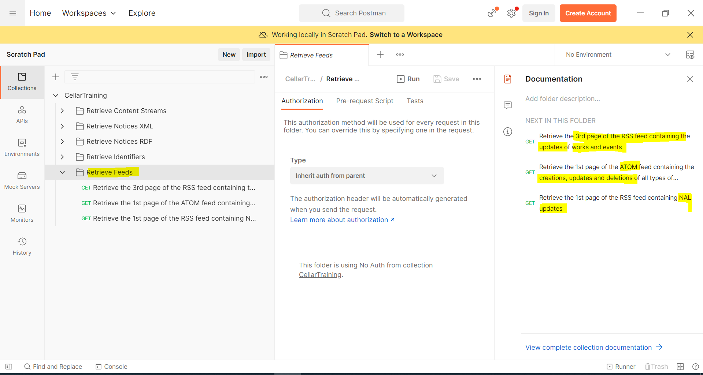
Let’s try out some requests from Postman!
Cellar’s REST API: Retrieve Feeds
Notes:
Application/pdf
application/xhtml+xml
application/xml;type=fmx4

Slide 33
Part 5: Accessing metadata using REST API

Slide 34
REST API
HTTPS operations to retrieve metadata about objects
Retrieve metadata for an object (work, expression, etc) in XML or RDF format.
Retrieve all the identifiers of a specific resource (sameAs)

Slide 35
Notices
Cellar’s REST API: Overview of Notice types
Notices are documents in either XML or RDF/XML format, that carry (meta)data, technical and structural data about resources: works, expressions, manifestations, identifiers, dossiers, events, agents.
There are several types of notices:
XML Tree notice (full hierarchical structure of a work)
XML Branch notice (full hierarchical structure of single expression)
XML Object notice (description of a single element of a hierarchy)
XML Identifier notice (list of equivalent identifiers to a given identifier)
RDF Tree notice (full RDF representation of specific work, dossier, event, or agent, with or without inferred triples)
RDF Object notice (single RDF representation of either work, expression, manifestation, dossier, event, or agent), with or without inferred triples)

Slide 36
Cellar’s REST API – Examples
Retrieve XML tree notice
curl -H "Accept:application/xml;notice=tree"
"http://publications.europa.eu/resource/oj/JOL_2014_001_R_0001_01?language=eng"
Retrieve XML branch notice
curl -H "Accept:application/xml;notice=branch” -H "Accept-Language:fra"
"http://publications.europa.eu/resource/oj/JOL_2014_001_R_0001_01?language=eng"
Retrieve XML object notice
curl -H "Accept:application/xml;notice=object"
"http://publications.europa.eu/resource/oj/JOL_2014_001_R_0001_01?language=eng"
Retrieve RDF tree notice
Asserted + Inferred
curl -H "Accept:application/rdf+xml;notice=tree"
"http://publications.europa.eu/resource/oj/JOL_2014_001_R_0001_01
Inferred excluded
curl -H "Accept:application/rdf+xml;notice=non-inferred-tree"
"http://publications.europa.eu/resource/oj/JOL_2014_001_R_0001_01

Slide 37
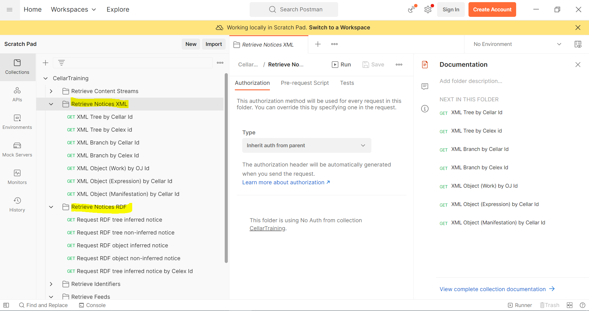
Let’s try out some requests from Postman!
Cellar’s REST API: Retrieve metadata
Notes:
Application/pdf
application/xhtml+xml
application/xml;type=fmx4

Slide 38
Part 6: Accessing metadata using SPARQL

Slide 39
SPARQL
SPARQL is a query language to search RDF triples (subject – property - object)
Subject | Property | Object
cellar:db594e8d-c430-11ec-b6f4-01aa75ed71a1 | rdf:type | cdm:official-journal
cellar:db594e8d-c430-11ec-b6f4-01aa75ed71a1 | owl:sameAs | oj:JOC_2022_171_R
cellar:db594e8d-c430-11ec-b6f4-01aa75ed71a1 | cdm:work_date_document | 2022-04-25
cdm:official-journal | rdfs:label | Official Journal
rdfs:label
Official Journal
cdm:official-journal
rdf:type
prefix cellar:<http://publications.europa.eu/resource/cellar/>
select ?property ?object
where
{
cellar:db594e8d-c430-11ec-b6f4-01aa75ed71a1 ?property ?object .
}
owl:sameAs
cellar:db594e8d-c430-11ec-b6f4-01aa75ed71a1
oj:JOC_2022_171_R
cdm:work_date_document
2022-04-25
Notes:
SPARQL: Declare what you have and declare what you want.
oj:JOA_1952_001_R
Celex:31952S0003

Slide 40
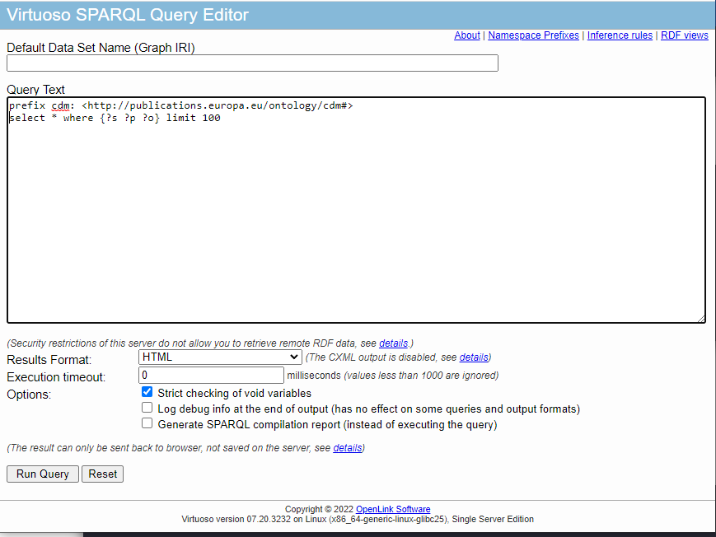
Virtuoso SPARQL Query Editor
Accessing data with SPARQL
http://publications.europa.eu/webapi/rdf/sparql

Slide 41
Virtuoso SPARQL : preliminaries
Accessing data with SPARQL
Notion of normalization:
All data attached to the Cellar identifier
No inferred data

Slide 42
Retrieve other identifiers of a publication
Accessing data with SPARQL
prefix cdm: <http://publications.europa.eu/ontology/cdm#>
prefix rdf: <http://www.w3.org/1999/02/22-rdf-syntax-ns#>
SELECT ?uri ?psi
WHERE {
?uri owl:sameAs <http://publications.europa.eu/resource/oj/JOC_2022_182_R_0001>.
?uri owl:sameAs ?psi.
}
Notes:
https://forms.office.com/e/4hWmk9Nx6f

Slide 43
Retrieve languages and formats
Accessing data with SPARQL
prefix cdm: <http://publications.europa.eu/ontology/cdm#>
prefix rdf: <http://www.w3.org/1999/02/22-rdf-syntax-ns#>
SELECT ?lang_en ?format
WHERE {
?work owl:sameAs <http://publications.europa.eu/resource/oj/JOC_2022_182_R_0001>.
?expression cdm:expression_belongs_to_work ?work.
?manifestation cdm:manifestation_manifests_expression ?expression.
?item cdm:item_belongs_to_manifestation ?manifestation.
?expression cdm:expression_uses_language ?languageConcept.
?languageConcept skos:prefLabel ?lang_en.
FILTER(LANG(?lang_en)="en")
?manifestation cdm:manifestation_type ?format.
}
Notes:
https://forms.office.com/e/4hWmk9Nx6f

Slide 44
Retrieve all metadata about the work of a publication
Accessing data with SPARQL
prefix cdm: <http://publications.europa.eu/ontology/cdm#>
prefix rdf: <http://www.w3.org/1999/02/22-rdf-syntax-ns#>
SELECT ?work ?p ?o
WHERE {
?work owl:sameAs <http://publications.europa.eu/resource/oj/JOC_2022_182_R_0001>.
?work ?p ?o.
}
Notes:
https://forms.office.com/e/4hWmk9Nx6f

Slide 45
Retrieve all metadata about a publication (languages and formats included)
Accessing data with SPARQL
prefix cdm: <http://publications.europa.eu/ontology/cdm#>
prefix rdf: <http://www.w3.org/1999/02/22-rdf-syntax-ns#>
SELECT ?work ?pWork ?oWork ?expression ?pExpression ?oExpression ?manifestation ?pManifestation ?oManifestation ?item ?pItem ?oItem
WHERE {
?work owl:sameAs <http://publications.europa.eu/resource/oj/JOC_2022_182_R_0001>.
?expression cdm:expression_belongs_to_work ?work.
?manifestation cdm:manifestation_manifests_expression ?expression .
?item cdm:item_belongs_to_manifestation ?manifestation .
?work ?pWork ?oWork .
?expression ?pExpression ?oExpression.
?manifestation ?pManifestation ?oManifestation.
?item ?pItem ?oItem.
}
limit 1000
Notes:
https://forms.office.com/e/4hWmk9Nx6f

Slide 46
Retrieve Official Journals published in 2022
Accessing data with SPARQL
prefix cdm: <http://publications.europa.eu/ontology/cdm#>
prefix rdf: <http://www.w3.org/1999/02/22-rdf-syntax-ns#>
SELECT ?uri
WHERE {
?uri cdm:official-journal_year "2022"^^xsd:gYear .
?uri rdf:type cdm:official-journal .
}
Notes:
https://forms.office.com/e/4hWmk9Nx6f

Slide 47
Let's add business identifier into result set
Accessing data with SPARQL
prefix cdm: <http://publications.europa.eu/ontology/cdm#>
prefix rdf: <http://www.w3.org/1999/02/22-rdf-syntax-ns#>
SELECT ?uri ?businessIdentifier
WHERE {
?uri cdm:official-journal_year "2022"^^xsd:gYear .
?uri rdf:type cdm:official-journal .
?uri owl:sameAs ?businessIdentifier .
}
Notes:
prefix cdm: <http://publications.europa.eu/ontology/cdm#>
prefix rdf: <http://www.w3.org/1999/02/22-rdf-syntax-ns#>
SELECT ?uri ?businessIndentifier
WHERE {
?uri cdm:official-journal_year "2022"^^xsd:gYear .
?uri rdf:type cdm:official-journal .
?uri owl:sameAs ?businessIndentifier .
}

Slide 48
Retrieve Official Journals published in specific time period
Accessing data with SPARQL
prefix cdm: <http://publications.europa.eu/ontology/cdm#>
prefix xsd: <http://www.w3.org/2001/XMLSchema#>
prefix rdf: <http://www.w3.org/1999/02/22-rdf-syntax-ns#>
SELECT ?uri ?ojclass ?ojnumber ?ojcollection ?ojyear ?workdatedoc
WHERE {
?uri cdm:official-journal_class ?ojclass .
?uri cdm:official-journal_number ?ojnumber .
?uri cdm:official-journal_part_of_collection_document ?ojcollection .
?uri cdm:official-journal_year ?ojyear .
?uri cdm:work_date_document ?workdatedoc .
?uri rdf:type cdm:official-journal .
FILTER( ?workdatedoc >= "2022-01-01"^^xsd:date
&& ?workdatedoc < "2022-10-01"^^xsd:date)}
Notes:
R=regular OJ, typically the OJ of the day
A=annex OJ, complementing a OJ R
E=electronic OJ (OJs that were not published in paper at the time of paper)
I=urgent OJs that need to be published last minute. OJ prod cannot easily change the OJ numbers in preparation so having the possibility to issue a "I" one does not impact the other OJs that are in preparation...
M=maltese (or gaellic) OJ: usually published in one language, containing acts that were not published in that language in the original OJ...

Slide 49
(Since 2024) Retrieve Official Journals Act
Accessing data with SPARQL
prefix cdm: <http://publications.europa.eu/ontology/cdm#>
prefix rdf: <http://www.w3.org/1999/02/22-rdf-syntax-ns#>
SELECT ?uri
WHERE {
?uri cdm:official-journal-act_year "2024"^^xsd:gYear .
?uri rdf:type cdm:official-journal-act
.
}
Notes:
https://forms.office.com/e/4hWmk9Nx6f

Slide 50
Official journal act and business id
Accessing data with SPARQL
prefix cdm: <http://publications.europa.eu/ontology/cdm#>
SELECT distinct ?c_act ?act
where {
?c_act owl:sameAs ?act.
?c_act cdm:official-journal-act_year "2024"^^xsd:gYear .
FILTER (regex(?act,'/oj/')).
}
Notes:
prefix cdm: <http://publications.europa.eu/ontology/cdm#>
prefix rdf: <http://www.w3.org/1999/02/22-rdf-syntax-ns#>
SELECT ?uri ?businessIndentifier
WHERE {
?uri cdm:official-journal_year "2022"^^xsd:gYear .
?uri rdf:type cdm:official-journal .
?uri owl:sameAs ?businessIndentifier .
}

Slide 51
Retrieve case-law created in specific time period
Accessing data with SPARQL
Part 4: Practical session
prefix cdm: <http://publications.europa.eu/ontology/cdm#>
select distinct ?w ?class ?ecli ?title ?agent
where {
?w a ?class.
?w cdm:date_creation_legacy ?datedoc
OPTIONAL{?w cdm:case-law_ecli ?ecli.}
OPTIONAL{?e cdm:expression_belongs_to_work ?w.
?e cdm:expression_uses_language <http://publications.europa.eu/resource/authority/language/ENG>.
?e cdm:expression_title ?title.
?w cdm:work_created_by_agent ?agent .
}
FILTER( ?datedoc >= "2022-01-01"^^xsd:date && ?datedoc < "2022-12-01"^^xsd:date)
FILTER(?class in (<http://publications.europa.eu/ontology/cdm#document_cjeu>,
<http://publications.europa.eu/ontology/cdm#court-report>,
<http://publications.europa.eu/ontology/cdm#case-law>,
<http://publications.europa.eu/ontology/cdm#summary_case-law>,
<http://publications.europa.eu/ontology/cdm#summary_case-law_jure>))
}
order by ?class

Slide 52
Retrieve acts put in force in 2022 and still in force
Accessing data with SPARQL
Part 4: Practical session
prefix cdm: <http://publications.europa.eu/ontology/cdm#>
select ?act, ?date_entry_into_force, GROUP_CONCAT (?actID,',') as ?actIds
{
?act cdm:resource_legal_in-force "true"^^<http://www.w3.org/2001/XMLSchema#boolean>.
?act cdm:resource_legal_date_entry-into-force ?date_entry_into_force.
?act cdm:work_id_document ?actID
FILTER( ?date_entry_into_force>= "2022-01-01"^^xsd:date && ?date_entry_into_force< "2023-01-01"^^xsd:date)
}
order by ?date_entry_into_force

Slide 53
Retrieve metadata for court cases
Accessing data with SPARQL
prefix cdm: <http://publications.europa.eu/ontology/cdm#>
select
?case ?dossier_identifier ?dossier_title group_concat(?event,',') as ?events
?number_reference ?domain ?case_status ?court_identifier_court ?court_identifier_extension ?court_identifier_extension_number ?court_identifier_number ?court_identifier_year group_concat(?work,',') as ?works ?year_reference group_concat(?sameAs,',') as ?sameAs
where {
?case a cdm:case_court.
?event cdm:event_part_of_dossier ?case.
?case cdm:dossier_identifier ?dossier_identifier.
?case cdm:dossier_title ?dossier_title.
OPTIONAL{?case cdm:dossier_number_reference ?number_reference.}
OPTIONAL{?case cdm:case_court_domain ?domain.}
OPTIONAL{?case cdm:case_court_has_case-status ?case_status.}
OPTIONAL{?case cdm:case_court_identifier_court ?court_identifier_court.}
OPTIONAL{?case cdm:case_court_identifier_extension ?court_identifier_extension.}
OPTIONAL{?case cdm:case_court_identifier_extension_number ?court_identifier_extension_number.}
OPTIONAL{?case cdm:case_court_identifier_number ?court_identifier_number.}
OPTIONAL{?case cdm:case_court_identifier_year ?court_identifier_year.}
OPTIONAL{?case cdm:dossier_contains_work ?work}
OPTIONAL{?case cdm:dossier_year_reference ?year_reference.}
?case owl:sameAs ?sameAs.
} order by ?case
limit 1000

Slide 54
Retrieve Who is who data
Accessing data with SPARQL
prefix skos: <http://www.w3.org/2004/02/skos/core#>
prefix foaf: <http://xmlns.com/foaf/0.1/>
prefix euvoc: <http://publications.europa.eu/ontology/euvoc#>
prefix org: <http://www.w3.org/ns/org#>
prefix vcard: <http://www.w3.org/2006/vcard/ns#>
prefix person: <http://publications.europa.eu/resource/person>
SELECT DISTINCT *
where {
?per a foaf:Person. ?per foaf:name ?name .
?per foaf:givenName ?givenName .
?per vcard:hasGender ?gender .
?per foaf:familyName ?familyName .
?per org:hasMembership ?membership.
?per vcard:hasHonorificPrefix ?honorificPrefix .
?membership euvoc:positionComplement ?position .
?membership org:organization ?org .
?org skos:prefLabel ?label .
FILTER (str(?familyName) = 'METSOLA' && str(?givenName) = 'Roberta')
FILTER (lang(?position) = 'en' && lang(?label) = 'en')
}

Slide 55
SPARQL Mapper
Part 4: Practical session
HTTPS operations to exploit ontologies and vocabularies
Retrieve supported languages
Retrieve concept scheme(s)
Retrieve concept, concept relatives
Retrieve top concepts, domains
Etc.

Slide 56
SPARQL Mapper
parameters
SPARQL Mapper
https://publications.europa.eu/resource/authority/{table}/{code} with table=subject-matter and code=EMPL
SPARQL Endpoint
Virtuoso

Slide 57
Thank you! - Q&A -

