Slide 1
Cellar The Common Data Repository of the Publications Office
Publications Office of the EU
Directorate A: Data, Information and Knowledge Management Services
Unit A3: Digital Solutions and Process Efficiency
Section A3.001: Development of and Support for Dissemination Systems
2025
Notes:
Speaker: Emmanuelle

Slide 2
Agenda of the training
Part 1: Introduction
Part 2: Cellar’s architecture and data flows
Part 3: Cellar’s data model and knowledge graph
Part 4: Cellar services and added values
Part 5: Questions and answers

Slide 3
Who are the trainers?
Emmanuelle Gaillard, A3.001, IT Officer emmanuelle.gaillard@publications.europa.eu
Marko Vujasinovic, A3.005, Consultant marko.vujasinovic@ext.publications.europa.eu
Abdelfettah Feliachi, A3.005, Consultant abdelfettah.feliachi@ext.publications.europa.eu
Xavier Chapelant, A2.004, Consultant
xavier.chapelant@ext.publications.europa.eu

Slide 4
Acronyms
API | Application Programming Interface
CDM | Common Data Model (OWL ontology describing EU publications domain)
FORMEX | Formalized Exchange of Electronic Publications
FMX | FORMEX file extension (.fmx4)
IMMC | Interinstitutional Metadata Maintenance Committee
METS | Metadata Encoding & Transmission Standard
OJ | Official Journal of the EU
OP | Publication Office of the EU
OWL | Web Ontology Language
RDF | Resource Description Framework
SPARQL | SPARQL Protocol and RDF Query Language
UUID | Universally Unique Identifier
XML | Extensible Markup Language

Slide 5
Part 1
Introduction (about us and Cellar)

Slide 6
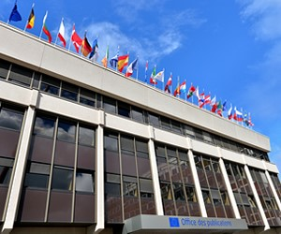
Publications Office of the European Union (OP)
Part 1: Introduction
The Publications Office of the European Union is the official provider of publishing services to all EU institutions, bodies, and agencies (Decision 2009/496/EC, Euratom, OJ L 168, 30.6.2009, p. 41). As such, it is the central point of access to EU law, as well as to publications, open data, research results, procurement notices and other official information. The Office thereby plays a central role in making it known to the public what the EU does and means for them, and in unlocking the power of data. Its mission is to support EU policies as a recognized competence centre for information, data and knowledge management, and to ensure that this broad range of information is available to the public as accessible and reusable data to facilitate transparency, economic activity and the diffusion of knowledge.
Notes:
To be skipped for OP people

Slide 7
About us
Part 1: Introduction
A.3 unit “Digital Solutions and Process Efficiency” under Directorate A “Data, Information and Knowledge Management Services”
Our mission and services are:
Reception of data from senders, Validation of metadata + content and Transformation of metadata (CERES team)
Enrichment with metadata, Storage and dissemination (Cellar team)
Dissemination (EUR-Lex team)
Innovation AI (AI team)
Business support
Service Management
System Management
Project Management
Notes:
Business Support: Assists in optimizing processes and ensuring efficient workflow management. Service Management: Oversees the delivery and quality of IT services to meet business needs. System management: Manages and maintains IT systems to ensure their reliability, performance, and security. Project management: Plans, executes, and finalizes projects to achieve specific goals within set constraints of time and resources.

Slide 8
With supports from…
Part 1: Introduction
A.2 unit “Data Operations and Enrichment Services” under Directorate A “Data, Information and Knowledge Management Services”
Monitoring and validation
Data curation tasks
For any questions or need related to data, please address to A2!

Slide 9
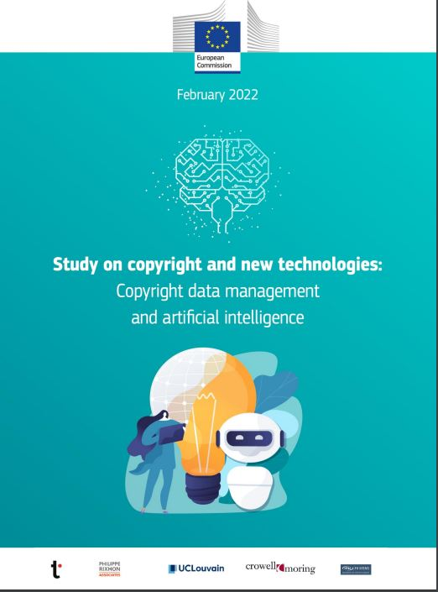
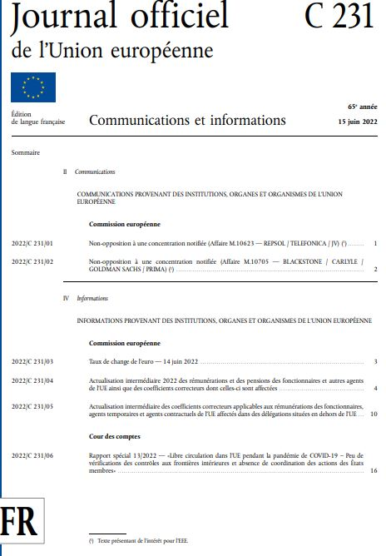
What do we publish?
Part 1: Introduction
Content

Slide 10
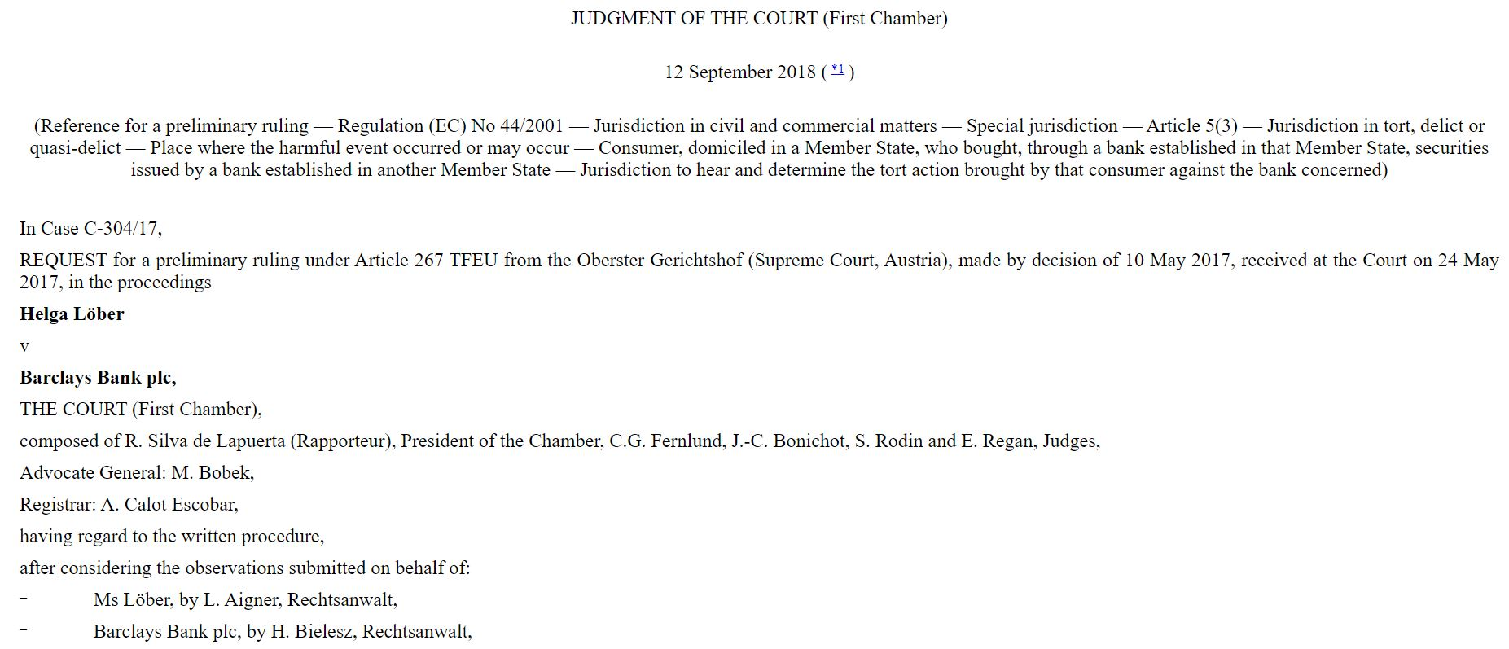
What do we publish?
Part 1: Introduction
Content

Slide 11
What do we publish?
Part 1: Introduction
...in different file formats & languages

Slide 12
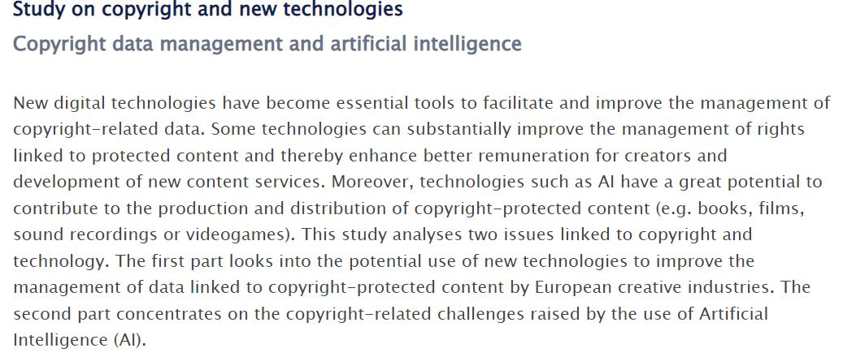
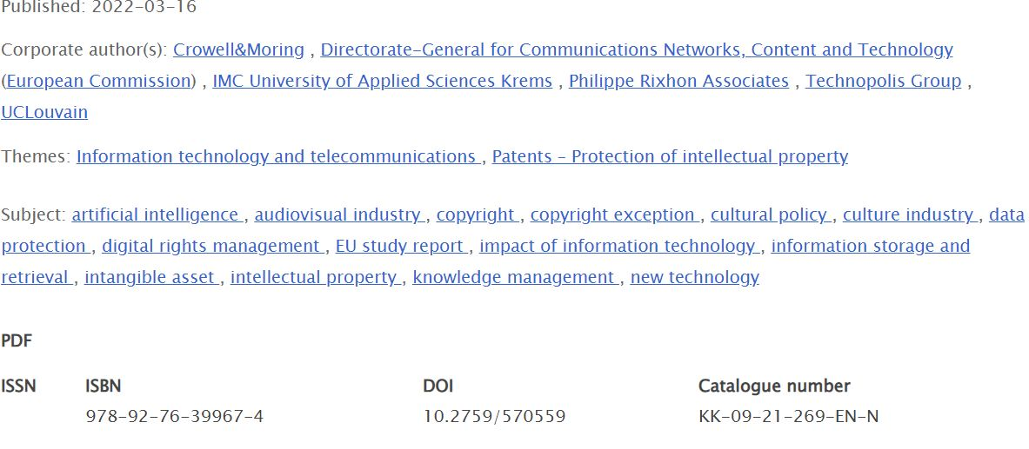
What do we publish?
Part 1: Introduction
Title, abstract, dates, subject, identifier etc.
Metadata

Slide 13
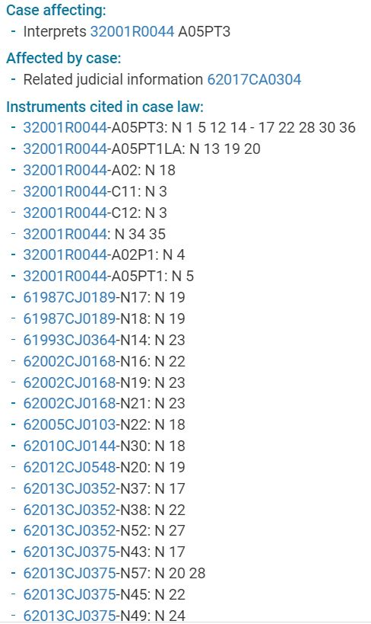
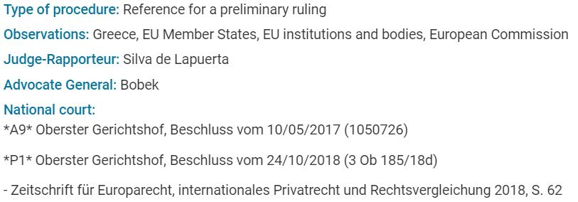
What do we publish?
Part 1: Introduction
Title, abstract, dates, subject, identifier, legal information etc.
Metadata

Slide 14
Part 1: Introduction
Let's start with Cellar...

Slide 15
Cellar: OP’s central data repository
Part 1: Introduction
Metadata
& semantics
Machine-readable
Cellar
OP’s central data repository
Open to all citizens for retrieval and (re)use
Digital content
Multilingual content
Notes:
The central data repository of the EU Publications Office
Contains DIGITAL CONTENT, such as EU’s legal & general publications
Contains METADATA and SEMANTICS about the digital content, stored inside a graph database (KNOWLEDGE GRAPH)
Multilingual (availability of digital content and metadata in the 24 EU languages)
Human-readable and machine-readable
Open to all citizens, promoting transparency and diffusion of knowledge

Slide 16
Why Cellar exists?
Part 1: Introduction
Store and disseminate (provide access to) content & metadata
Provide rich and exploitable links between the publications
Disseminate the metadata as Linked Open Data
Feed automatically the long-term archive, EUDOR

Slide 17
What knowledge does Cellar stores that users can access?
Part 1: Introduction
EU Legal publications: Treaties, secondary legislation, authentic Official Journal, legal analysis metadata, EU case law & selected national case law, etc.
EU General publications : Annual reports, Studies, etc.
Only metadata: WhoIsWho directory of the EU
Procurement domain TED
Other knowledge domains: ECB archives, NIMS
EU Master Data :
CDM, EUROVOC Thesauri, Authority Tables, etc
…

Slide 18
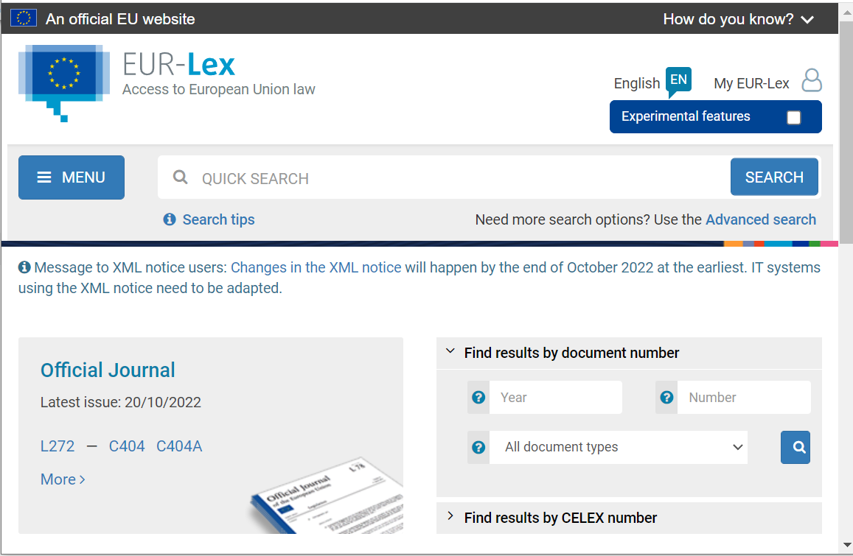
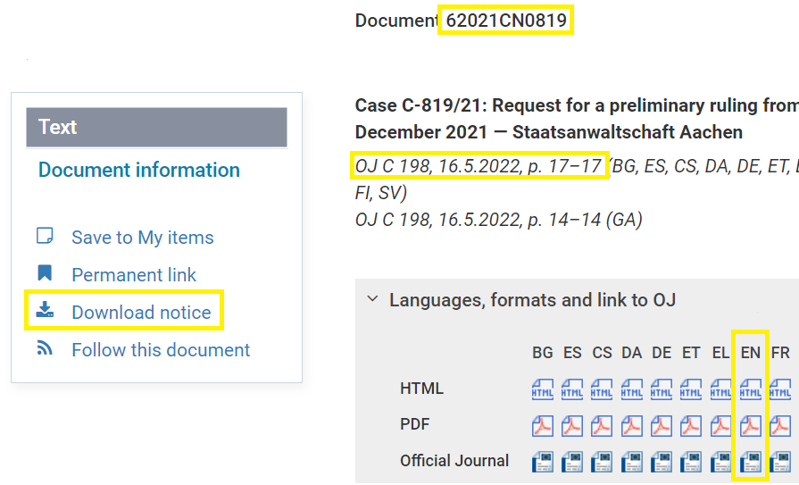
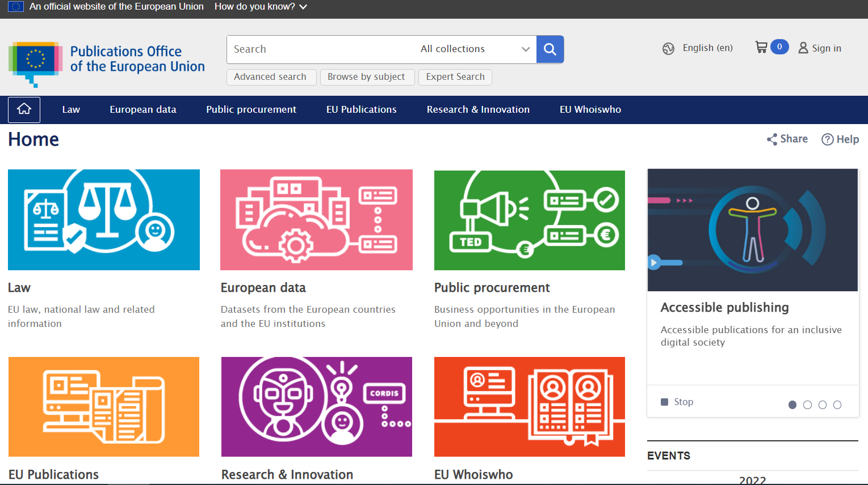
Who is using Cellar for access and how?
Part 1: Introduction
Cellar clients
EUR-Lex
REST API (digital content + metadata)
VIRTUOSO Interface (metadata)
Cellar clients
OP Portal
REST API (digital content +metadata)
VIRTUOSO Interface (metadata)
External clients
REST API (digital content + metadata)
VIRTUOSO Interface (metadata)
Notes:
There are many users as we will see in the section where we talk about usage statistics and KPIs.
Most notable users are EUR-Lex and OPPortal

Slide 19
External clients – (re)Users
Part 1: Introduction
European Union Institutions and Agencies
For official publications, accessing directly Cellar
For data storage and access, in case of lack of infrastructure and expertise in data management, etc.
Academic & Research Institutions
Universities
Research: JRC, etc.
Other clients
Other Publishers (Academic, Professional, etc.)
Developers to train AI models
Enterprises
Lawyers
EU member states

Slide 20
Part 2
Cellar: Architecture and Data Flows
Notes:
Speaker: Emmanuelle

Slide 21
Where is the Cellar ecosystem in the publication process?
Part 2: Architecture
CERES
Reception & Validation
IMMCbuilder
UPP
Storage & Dissemination
Cellar
EUDOR
Access & Search
EUR-Lex, OPPortal etc.

Slide 22
Main Dataflows
Part 2: Architecture
INGESTION
The process of collecting and storing Data and Metadata provided in a standard structure
DISSEMINATION
The process of transmitting Data and/or Metadata in formats supported by Cellar when requested by clients
Cellar
METS package
Ex: containing the pdf of an official journal + the metadata describing the document
Actual document or metadata
Ex: the XHTML of an OJ in a specific language, XML or RDF metadata about linguistic version , etc.
Done through content negotiation

Slide 23
METS packages
Part 2: Architecture
Metadata Encoding and Transmission Standard* (METS) - a zip package
Cellar understands METS
Allow to create/update/delete metadata and digital content in Cellar
How it is produced?
Automatically by CERES, via the IMMC2CDM Rules and corresponding engine.
UPP, TED, DORIE, …
Manually, by A2 Cellar team, for correction purposes
By archivist in Cellar
*http://www.loc.gov/standards/mets/

Slide 24
Cellar data ingestion flow
Part 2: Architecture
Receive METS package
Validate package
Metadata validation
Metadata
Inference
Storage
Response

Slide 25
Cellar data ingestion flow
Part 2: Architecture
Receive METS package
Validate package
Metadata validation
Metadata
Inference
Storage
Response
Cellar recieves the METS package in a priority folder depending of the priority of the package

Slide 26
Cellar data ingestion flow
Part 2: Architecture
Receive METS package
Validate package
Metadata validation
Metadata
Inference
Storage
Response
Validation of the package, e.g. :
Is the zip package free of corruption?
Is the syntax of the METS file correct?
Are the formats of the digital files authorized?
…

Slide 27
Cellar data ingestion flow
Part 2: Architecture
Receive METS package
Validate package
Metadata validation
Storage
Metadata
Inference
Response
Validation of the metadata, e.g. :
Are the descriptors used among the valid ones?
Are the resources appropriately described?
Does the vocabulary used exist?
…

Slide 28
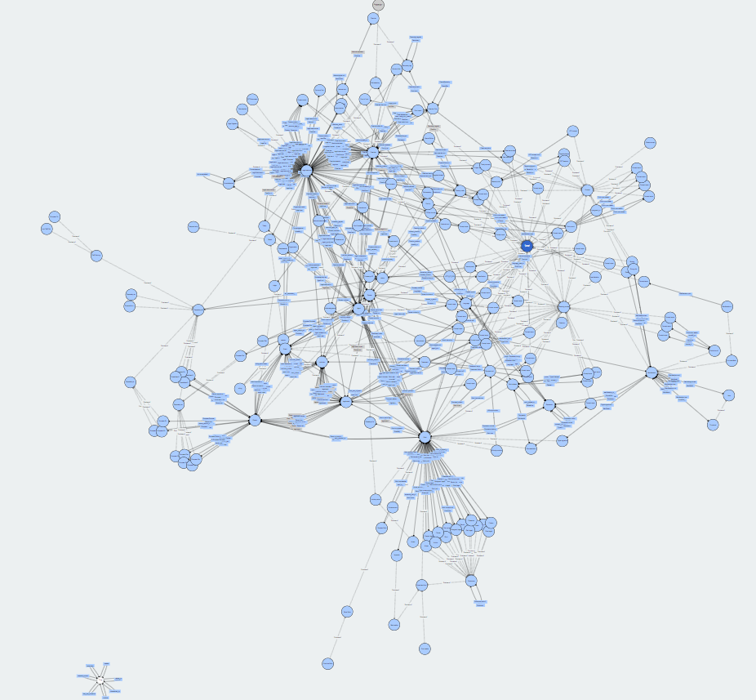
Cellar data ingestion flow
Part 2: Architecture
Receive METS package
Validate package
Metadata validation
Metadata
Inference
Storage
Response
CDM Ontology
Asserted metadata
Inferred & asserted metadata

Slide 29
Cellar data ingestion flow
Part 2: Architecture
Receive METS package
Validate package
Metadata validation
Storage
Metadata
Inference
Response
Digital file stored in S3
Non inferred data stored in the knowledge graph + S3
Inferred data stored in the database + S3
Technical metadata stored in the knwoledge graph + S3
Other data stored on the database (historic, versionning, …)
…

Slide 30
Cellar data ingestion flow
Part 2: Architecture
Receive METS package
Validate package
Metadata validation
Storage
Metadata
Inference
Response
Response of the ingestion:
- Mets package / json answer

Slide 31
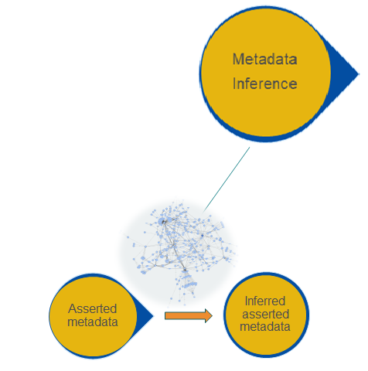
Inference
Part 2: Architecture
(Deductive) Inference is the process of deriving new knowledge from existing (asserted) knowledge based on a logical reasoning.
Ontologies formalize the logic to provide a frame for inference.
Knowledge inference is another way to do AI.
cites
Inverse of
cited by
cites
Doc1
cites
Doc2
Doc1
Doc2
cited by

Slide 32
Dissemination: How can you use Cellar’s data?
Part 2: Architecture
Virtuoso/SPARQL to retrieve metadata | https://publications.europa.eu/webapi/rdf/sparql
REST API to retrieve metadata and content | http://publications.europa.eu/resource/{ps-name}/{psid}?{parameters} + header’s keys.
RSS feeds about ingestion | http://publications.europa.eu/webapi/notification/ingestion ?{parameters}

Slide 33
Cellar’s ecosystem architecture
Part 2: Architecture
Public re/users
EUR-Lex
OP PORTAL
UPP
IMMC- builder
archivist
RSS & REST API
SPARQL Interface
METS
Cellar
Knowledge Graph
IMMC
CERES
METS
METS
Others:
-A2
-TED
-DORIE - …
METS
EUDOR
File System
Relational Database
Notes:
Add mets to eudor
BREAK : 20min

Slide 34
Additional features
Features for METS senders:
Embargo: possibility to hide a publication for anyone:
Could be done from the ingestion, no one will know about this ingestion and dissemination not possible
Could be done after ingestion. Warning: the publication was visible/available to download at a moment
Activation of rdf content : the content of a rdf digital file could be stored and queried in Virtuoso. Could used any ontology. See WhoIsWho, TED.

Slide 35
Additional capabilities
Status service: track ingestion of a package or a resource
Indexation: indexation of publications for EUR-Lex search
Export: create METS from Cellar to reingest in other environments

Slide 36
Part 2: Architecture
Cellar in numbers...
Notes:
Speaker: Abdel

Slide 37
Number of publications in Cellar per collection (jan 2025)
Part 2: Architecture
Collection name | Total
General publications | 220,351
Legal resources | 1,031,258
Official Journal Official Journal Act Secondary legislation (regulations, decisions, directives, budgets, opinions, guidelines, etc.) Preparatory acts Case law National implementing measures OJ C series …. | 44,565 14,665 175,491 266,882 89,384 186,239 51,635 ….
Multiply by number of languages and by number of file formats
Notes:
Say that numbers are in fact much bigger, taking into account multiplication by 24 (languages) and multiplication by number of manifestations (file formats).

Slide 38
Cellar’s ingestion statistics
Part 2: Architecture
Avg. Monthly in 2024 | ~93500
Avg. Daily in 2024 | ~3100
Notes:
Need to give explanations in case we have questions for the day 08/10

Slide 39
Distribution of API requests per file type
Part 2: Architecture

Slide 40
Magnitude of Cellar’s dissemination
Part 2: Architecture
Cellar's API
metadata
digital content
RSS
SPARQL
metadata
~29 million hits per day in 2024
Notes:
Need to update it

Slide 41
Magnitude of data in Cellar (January 2025)
Part 2: Architecture
Digital content size
46 million files, and growing
Virtuoso size
>1.3 billion piece of data (triples)

Slide 42
Cellar vs. other Linked Open Data repositories
Part 2: Architecture
Statistics from Oct 2nd 2023:
Wikidata (15,206,827,913 triples)
Europeana (2,836,270,332 triples)
DBpedia (1,152,979,851 triples)
Cellar (1,021,347,746 triples)
data.europa.eu (769,597,496 triples)
statistics.gov.scot (771,764,686 triples)
..
Statistics from Jan 16th 2025:
Wikidata(16,460,212,137 triples)
Europeana(2,836,270,332 triples)
Cellar (1,363,973,379 triples)
DBpedia (1,152,979,851 triples)
data.europa.eu (966,906,171 triples)
statistics.gov.scot (803,554,718 triples)
..
Notes:
schema.org - over 10 million sites use schema.org’s collection of shared vocabularies to markup their web pages. Many applications from Google, Microsoft, Pinterest, Yandex and others already use these vocabularies to power rich, extensible search experiences¹.
¹ https://schema.org/
Amazon's Alexa - ”..using schema.org as the base of the Alexa Ontology means that it shares a vocabulary used by more than 10 million websites, which can be linked to the Alexa ontology... Alexa meaning representation language leverages classes, properties, actions, roles and operators in the main ontology to create a compositional, graph-based representation of the meaning of an utterance” ²
² Kollar, Thomas, et al. "The Alexa Meaning Representation Language." NAACL-HLT (3). 2018.
Google’s Knowledge Graph – used by Google Search engine
Facebook’s Graph – to support natural language queries and new applications development based on Graph API
Europeana - digitized cultural heritage collections of thousands of European archives, libraries and museums
DBpedia – a knowledge graph of Wikipedia, structured using DBpedia ontology
IBM Watson AI system - has a knowledge graph that is partially uses YAGO, a KG also extracted from Wikipedia
Wikidata – also an other famous structured data source based on Wikiepedia that exposes data as LD
Many datasets from different fields can be found on Linked Open Data Could (https://lod-cloud.net/) ...

Slide 43
Part 3:
How is Cellar’s data organized and structured?
Notes:
Speaker: Abdel

Slide 44
Part 3: Data
Embracing the vision of the Semantic Web and Linked Open Data

Slide 45
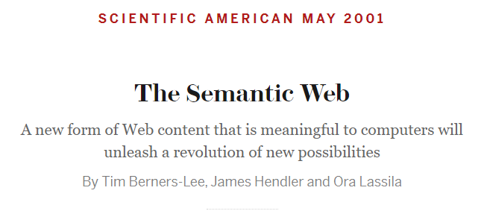
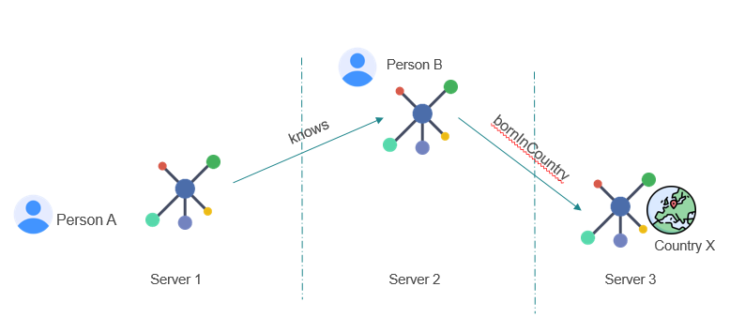
Part 3: Data
Design Principles of Linked Open Data*
Use URIs as names for things
Use HTTP URIs so that people can look up those names
When someone looks up a URI, provide useful information, using the standards (RDF/S, SPARQL)
Include links to other URIs so that they can discover more things
Notes:
..information is given well-defined meaning [with common vocabularies and ontologies], better enabling computers and people to work in cooperation..
enables machines to COMPREHEND semantic documents and data..
assists the evolution of human knowledge as a whole
Linked Data is the Semantic Web done right

Slide 46
Our Data are FAIR
The linked data principles are the key to make them FAIR*
Findable
Accessible
Interoperable
Reusable
*https://www.go-fair.org/fair-principles/

Slide 47
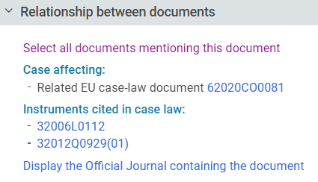
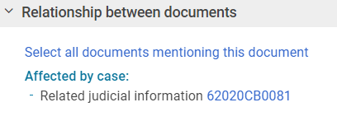
Our data are linked by default
Part 3: Data

Slide 48
Data layers in Cellar
Part 3: Data
Structure and Formats
Semantics
METADATA: Structured data about the digital content
DATA: Digital Content
(documents in specific file formats and EU languages)
COMMON VOCABULARY
AUTHORITY TABLES
THESAURI
Data Definition Layer
Data Layer
Knowledge
Graph
Knowledge Base

Slide 49
Metadata are represented as triples
Part 3: Data
A triple can be seen as a sentence of 3 parts: subject – verb (property) – object
This 3 part structure is named triple and are grouped in RDF format
PAUL
EATS
APPLE
The french pdf of the OJ 123
has_type
« pdf »
The OJ 123
cites
the OJ 456

Slide 50
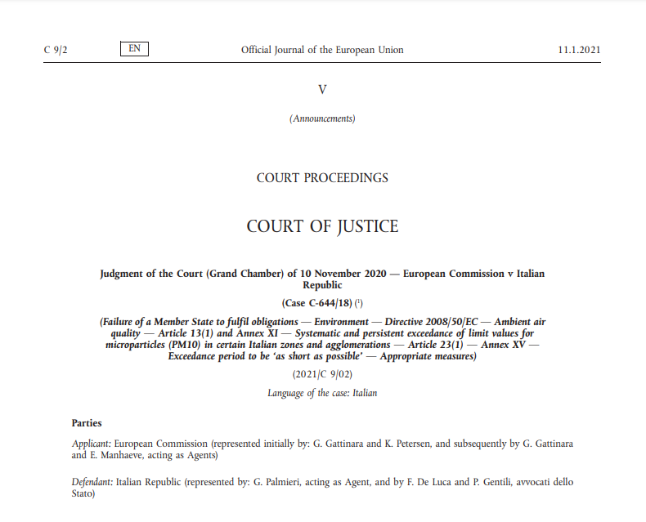
WEMI
CDM defines subtypes of Work, including General Publication, Official Journal, Special edition of General Publication, Legal Resource, Consolidated act, Preparatory act, etc.
Part 3: Data
Expression
Manifestation
Item
Work
Official
Journal
(JOC 2021 009)
ENG
pdf
ALL 23/24 LVs
fmx4
xhtml
FRA
digital item (physical file)
High-level concept, an intellectual or artistic creation, for example a specific Official Journal
expression_
belongs_to_work
Language level; linguistic version of the work
manifestation_
manifests_expression
Format level; a format of specific linguistic version of the work
item_
belongs_to_
manifestation
Physical/digital file level – file itself
Notes:
CDM based on FRBR (Functional Requirements for Bibliographic Record) to present a publication at different levels of abstraction: Work, Expression, Manifestation, and Item (WEMI)
WEMI hierarchy in cellar
Work: high-level abstract -- The representation of a specific OJ
Expression: language level – The representation of the French version of the specific OJ
Manifestation: format level – The representation of the pdf format of the French version of the specific OJ
Item: physical/electronic file level – The file itself

Slide 51
Three WEMI hierarchies in Cellar
Part 3: Data
Work-expression-manifestation-item (WEMI) hierarchy for digital content (content streams) representation
Dossier-event hierarchy for dossiers and sequence of events related to dossiers (from initiation to conclusion)
Agent hierarchy for representing countries, persons, organisations, groups, committee, institutions, courts etc.

Slide 52
Cellar’s resource identifiers (URI)
Part 3: Data
From the business reason, a resource can have multiple identifiers (Cellar identifier and business identifiers)
http://publications.europa.eu/resource/cellar/c686c133-cb43-11ec-b6f4-01aa75ed71a1
http://publications.europa.eu/resource/oj/JOC_2022_182_R_0001
http://publications.europa.eu/resource/celex/52022XC0504%2801%29
Work | http://publications.europa.eu/resource/oj/JOC_2022_182_R_0001
Expression | http://publications.europa.eu/resource/oj/JOC_2022_182_R_0001.ENG
Manifestation | http://publications.europa.eu/resource/oj/JOC_2022_182_R_0001.ENG.xhtml
Item | http://publications.europa.eu/resource/oj/JOC_2022_182_R_0001.ENG.xhtml.C_2022182EN.01000101.doc.html

Slide 53
Cellar’s resource identifiers (URI)
Part 3: Data
Resources in Cellar are identified by their unique identifiers which take the form of Web URIs.
For example:
http://publications.europa.eu/resource/cellar/c686c133-cb43-11ec-b6f4-01aa75ed71a1 | Work
http://publications.europa.eu/resource/cellar/c686c133-cb43-11ec-b6f4-01aa75ed71a1.0006 http://publications.europa.eu/resource/cellar/c686c133-cb43-11ec-b6f4-01aa75ed71a1.0013 | Expression
http://publications.europa.eu/resource/cellar/c686c133-cb43-11ec-b6f4-01aa75ed71a1.0013.01 | Manifestation
http://publications.europa.eu/resource/cellar/c686c133-cb43-11ec-b6f4-01aa75ed71a1.0006.01/DOC_1 | Item
http://publications.europa.eu/resource/authority/country/BEL | Concept
http://publications.europa.eu/resource/directory/person/EURCOU_IND-CONSIL.BELFED.01 | Person
Notes:
{work-id} is a valid Universally Unique Identifier (UUID)
{expr-id} is a 4-chars numeric value
{man-id} is a 2-chars numeric value
{cs-id} is an alphanumeric value with following pattern: DOC_x, where x is an incremental numeric value that identifies the content stream

Slide 54
Part 4:
Cellar services and added values
Notes:
Speaker: Emmanuelle

Slide 55
Value from using our services
Part 4: Services and Added values
Meet the needs of the clients
Build new services on top of our services
Semantic Web and Data Management advising
Exclusive business needs are met for each client
Monitoring and statistics about ingestion and dissemination
Help to clarify requirements, business analysis
Beta testing, etc.
Investigate an incident
Assistance to use Cellar services
Assistance to retrieve proper data
Clarify architecture

Slide 56
Cellar added values
Part 4: Services and Added values
Facilitate access and promote transparency and re-use
Easy and standardized way to publish
Facilitate search
Facilitate access
Eliminates redundancy: Standardization reduces duplication of efforts
Harmonization across borders

Slide 57
Cellar added values
Part 4: Services and Added values
Semantic Web & Linked Open Data principles
Making connected data on the web easy for machines to use
Anyone can use or share the data, even in huge amounts!
Linking the same information in many places.
Authority data access and usage
Helping AI systems
Promote transparency and re-use

Slide 58
Cellar added values
Part 4: Services and Added values
A2 ensure quality
Follow up and statistics
Quality control of metadata and content
Ensure trustworthiness of data
Facilitation of tracking of change
Data curation
Automation of updates
Monitoring publication process
Notes:
1 What do we provide, whih fetaure functionnaly This functionality is used by Eurlex That mean to link date And then the values
Follow upd and statistics about a system (A3) Remove parenthesis

Slide 59
Cellar added values
Part 4: Services and Added values
A1 ensure data modelling
Modelling of the CDM ontology based on business need
Creation/update of authority tables

Slide 60
Save on...
Part 4: Services and Added values
Time
Once a publication workflow is set, the work is done.
Costs
Technical infrastructure and storage costs
Already available access interfaces (EUR-Lex, OP Portal Widgets*, etc.)
Already available business & technical monitoring
* https://op.europa.eu/en/web/webtools/op-widgets
Notes:
Buisness agnostic system Example of ABA, TED, …

Slide 61
Cellar team achievements (2024)
Part 4: Services and Added values
Improved stability of Cellar:
Ingestion performance increased of 30%
Cellar is processing 5400 TED notices in addition per day, without any issue
Dissemination performance increased up to 40%
Cellar is providing response faster and more reliable

Slide 62
Cellar team achievements (2024)
Part 4: Services and Added values
Improved quality of Cellar by:
Introducing new type of testing, like performance testing or comparison of generated RDFs
Introducing the checklist – through which we follow-up of all activities we have to do before any release could go to Production
Improving the security – we have addressed most of the security concerns listed in ITSP2021, ITSP2023, Fortify cans, Dependency checks and GRC controls

Slide 63
Future Cellar features
Part 4: Services and Added values
Protected data
Notification service
AI initiatives
Automatic upload of the CDM ontology
Test tool

Slide 64
Interested in using Cellar services?
Part 4: Services and Added values
New users are welcome ☺
Technically, Cellar can be scaled up to allow more data to be ingested
Even if you do not have the necessary tools to standardize and send us your data, we can help you and provide the related services.
Contact point from OP: OP-SMT-CELLAR@ec.europa.eu
Contact point from external users: OP-CELLAR@ec.europa.eu
Cellar Website: https://op.europa.eu/en/web/cellar/home
Cellar team on sharepoint: https://eceuropaeu.sharepoint.com/sites/ORG-OP-MyUnit-04/SitePages/Cellar.aspx

Slide 65
Interested in using Cellar services?
Part 4: Services and Added values
Data related requests
A2 Semantic Data Competence Center (SDCC) team :
through an email OP-CELLAR-SD2C@publications.europa.eu
or by opening a ticket through https://citnet.tech.ec.europa.eu/CITnet/jira/projects/SDCC
Communication with end users
Helpdesk ticket
Notes:
BREAK : 20 min

Slide 66
Next session: 30th January 2025
Demo on how to retrieve content + metadata:
From API
From the knowledge graph Virtuoso
Notes:
Application/pdf
application/xhtml+xml
application/xml;type=fmx4

Slide 67
Thank you! - Q&A -

